Slide 1
SQL Programming
Sequences

Slide 2
Module 05: Sequences Page A-1: Intro
In this module we’re going to discuss a programming feature of most SQL implementations, that, as it turns out, is not called for, nor specified in the standard.
If you have experience with an Access database, this topic is analogous to the autonum feature. Autonum AUTOmatically assigns a NUMber sequence value to a column of data.
This is a handy tool to use when it comes to building primary keys, but I’m getting ahead of myself, so
Please turn the page…

Slide 3
Module 05: Sequences Page B-1: Attributes
In the earliest stages of the systems development life cycle, we use an Entity-Relationship diagram to model and show the necessary data elements in our application.
This ER diagram depicts three primary elements that will eventually be represented in the database:
Entities → tables
Attributes → columns
Relationships → constraints (along with some other details)
We’ve already studied and used these database features, but I want to take a step back and chat about attributes for a moment.

Slide 4
Module 05: Sequences Page B-2: Descriptor Attributes
Attributes can be classified as either descriptor attributes or identifier attributes.
Descriptor attributes are used to describe the entity, or in database-speak, the columns are used to describe the record/row. These kinds of attributes are the most common, and frankly they’re the only ‘useful’ attributes in the entire system.
They describe the entity, they depict information about the object that we’re modeling. They carry information that’s important to the business.
Descriptor attributes include fields like: age, weight, height, major, class level, …
An identifier attribute doesn’t describe an entity, it merely locates an entity.

Slide 5
Module 05: Sequences Page B-3: Identifier Attributes
Quick, what’s your student ID?
If you visit the Academic Counseling Office, do they need to know your ID number in order to assist you with your academic goals and planning?

Slide 6
Module 05: Sequences Page B-4: Identifier Attributes
Quick, what’s your student ID?
If you visit the Academic Counseling Office, do they need to know your ID number in order to assist you with your academic goals and planning?
No, they don’t.
They want to know things like: your major, your career and academic goals, the courses you’ve taken, all that kind of stuff, but knowing your ID Number doesn’t help them in the least.

Slide 7
Module 05: Sequences Page B-5: Identifier Attributes
What’s you driver’s license number?
What’s the purpose of a driver’s license?
To vouch for you as a skilled driver. The license is awarded only after you’ve passed a test, and in that sense, it’s a receipt of sorts that attests to your skills.
If you are stopped by a police officer they may ask you for your license. In this case they’ll be looking to authenticate that the license belongs to you. They’ll compare your physical characteristics with those that are described on the license.
Hair color, eye color, weight, name, and address are all descriptor attributes that describe you.
So then, what’s the driver’s license number used for?

Slide 8
Module 05: Sequences Page B-6: Identifier Attributes
The driver’s license number is used to locate your record, that’s all. Every driver’s license has a unique driver’s license number, and that number is used to locate your record amidst all of the other records in the file.
That number is used to identify your record, but not describe you.
The driver’s license number is an identifier attribute, it is NOT a descriptor attribute.
Your social security number is an identifier attribute.
Your student id number is an identifier attribute.

Slide 9
Module 05: Sequences Page B-7: Primary Key
What is a primary key?

Slide 10
Module 05: Sequences Page B-8: Primary Key
What is a primary key?
A primary key is a column, or collection of columns, that uniquely identifies a row in a table.
The primary key is an identifier attribute.
Rarely does the primary key carry any meaning. It’s just a collection of characters that are used to uniquely identify any record. It has no meaning as far as the application is concerned other than to locate a record in the filing system.

Slide 11
Module 05: Sequences Page B-9: Primary Key
Well now, if the primary key has no meaning, then I’d just as soon assign a random number as the primary key, and be done with it.
Oracle sequences provide the programmer with an easy way to create and assign arbitrary / synthetic key values.

Slide 12
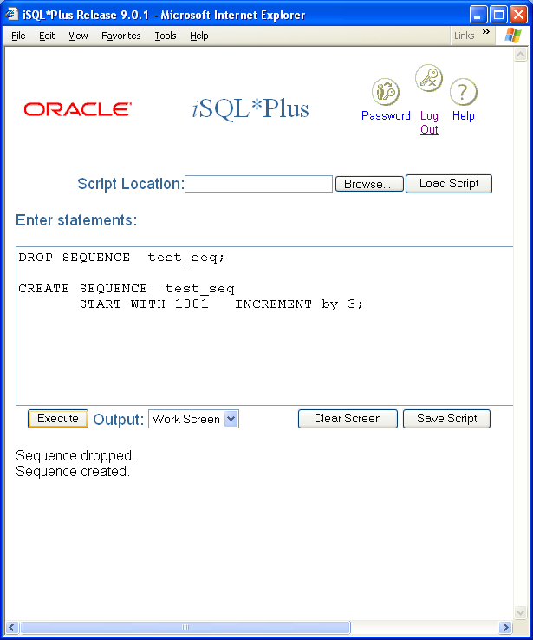
Module 05: Sequences Page C-1: Sequences
Part of the syntax for the CREATE SEQUENCE statement is:
CREATE SEQUENCE sequence_name
[START WITH number]
[INCREMENT BY number]
As with all schema objects, the CREATE statement is used to create the object. After identifying the type of object that is being created (SEQUENCE) a name for that object is provided.
With Oracle sequences, the programmer has the option of specifying the starting value for the sequence, and the increment that will be applied each time a sequence number is generated.
Sequence are removed from the database with the DROP Sequence statement:
DROP SEQUENCE sequence_name;

Slide 13
Module 05: Sequences Page C-2: Sequence Pseudocolumns
Associated with each sequence are two pseudo columns:
sequence_name.NEXTVAL
sequence_name.CURRVAL
NEXTVAL returns the next available sequence number (ie. NEXTVAL advances the sequence to the next iteration)
CURRVAL returns the current value of the sequence.

Slide 14
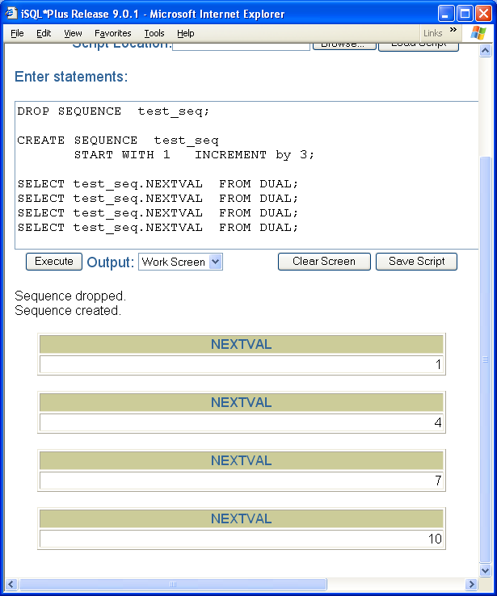
Module 05: Sequences Page C-3: NEXTVAL Pseudocolumn
Associated with each sequence are two pseudo columns:
sequence_name.NEXTVAL
sequence_name.CURRVAL
NEXTVAL returns the next available sequence number (ie. NEXTVAL advances the sequence to the next iteration)

Slide 15

Module 05: Sequences Page C-4: CURRVAL Pseudocolumn
CURRVAL returns the current value (ie. The last number generated) in the sequence.

Slide 16
Module 05: Sequences Page C-5: Challenge
We saw that the syntax for creating a sequence was something like this:
CREATE SEQUENCE sequence_name
[START WITH number]
[INCREMENT BY number]
And the example on the left, in addition to the previous few examples, demonstrated that this feature does ‘work’.
But?
Where in the syntax do we link the sequence with a particular table?
How do we tell Oracle which table this sequence is associated with?

Slide 17
Module 05: Sequences Page C-6: Challenge
We saw that the syntax for creating a sequence was something like this:
CREATE SEQUENCE sequence_name
[START WITH number]
[INCREMENT BY number]
And the example on the left, in addition to the previous few examples, demonstrated that this feature does ‘work’.
But?
Where in the syntax do we link the sequence with a particular table?
How do we tell Oracle which table this sequence is associated with?
We don’t!

Slide 18
Module 05: Sequences Page C-7: Challenge
Sequences are independent of tables!
Sequences stand on their own!
That’s why the FROM clause references the dual table, and that’s why we refer to NEXTVAL and CURRVAL as pseudocolumns.
They are ‘fake’ columns in that they don’t belong to any table. They stand on their own.
Hmmm.
Then how do we assign the NEXTVAL value to the primary key column in our table?

Slide 19
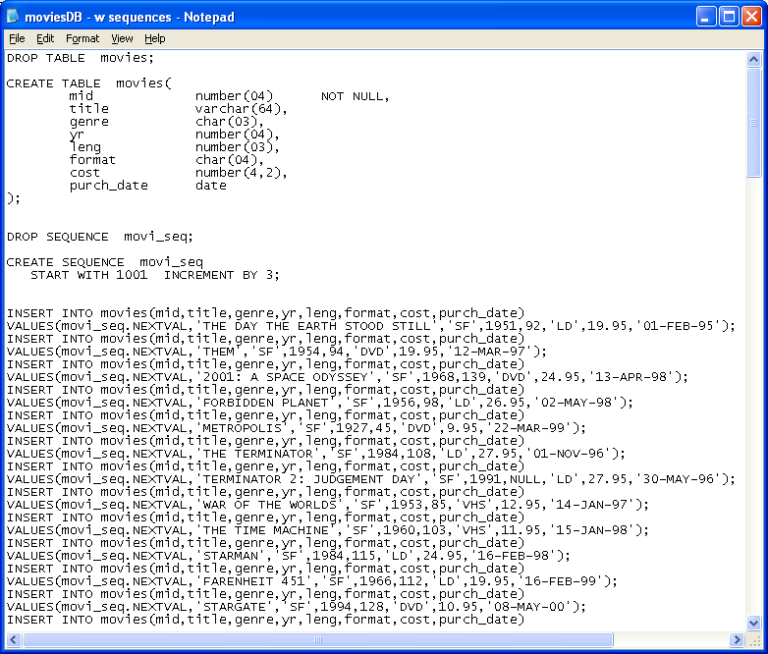
Module 05: Sequences Page C-8: Challenge
Sequences are independent of tables!
Sequences stand on their own!
That’s why the FROM clause references the dual table, and that’s why we refer to NEXTVAL and CURRVAL as pseudocolumns.
They are ‘fake’ columns in that they don’t belong to any table. They stand on their own.
Hmmm.
Then how do we assign the NEXTVAL value to the primary key column in our table?
By reference. We call, or refer to, the sequence when we ‘need it’. We treat the sequence value just as if it were a number (numeric literal or a numeric column) and we can use that value in an INSERT statement, or an UPDATE statement.

Slide 20
Module 05: Sequences Page C-9: Challenge
In this example, we refer to the sequence, by name, in the VALUES clause of our INSERT statement.
Each time movi_seq.NEXTVAL is called, the next sequence number is generated, and the pseudocolumn NEXTVAL holds that new value.

Slide 21
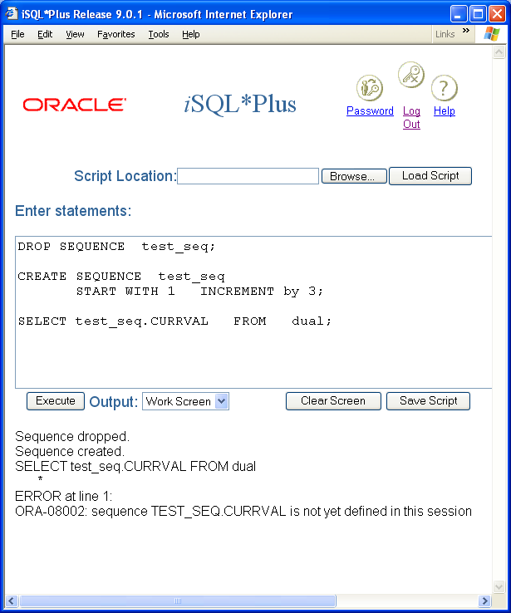
Module 05: Sequences Page C-10: Usage Note
In this example we demonstrate how to create a sequence.
We have an acknowledgement from Oracle that the sequence has been created.
BUT, we cannot reference the current value of that sequence, until after we’ve generated at least one sequence number. Until that point in time when a sequence number has been generated, Oracle will throw this error:
Sequence is not yet defined in this session

Slide 22
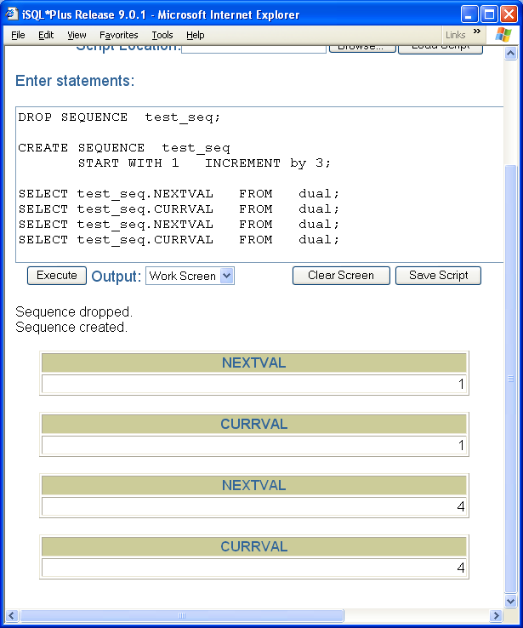
Module 05: Sequences Page C-11: Usage Note
Once the first sequence number has been generated, we can use the current value pseudo column.

Slide 23
Module 05: Sequences Page C-12: Usage Note
Sequences only move forward.
Once a sequence number has been generated that sequence will not re-issue that number. It’s already gone past that point, never to return.
Sigh!

Slide 24
Module 05: Sequences Page C-13: Complete Syntax
The complete syntax for the CREATE SEQUENCE statement is:
CREATE SEQUENCE sequence_name
START WITH number
INCREMENT BY number
MINVALUE number | NOMINVALUE
MAXVALUE number | NOMAXVALUE
CYCLE | NOCYCLE
CACHE | NOCACHE

Slide 25
Module 05: Sequences Page C-14: Complete Syntax
START WITH provides the starting value for the sequence
INCREMENT BY specifies the increment, or interval, between sequence numbers
MINVALUE specifies the smallest sequence value
MAXVALUE specifies the largest sequence value
CYCLE/NOCYCLE indicates whether the sequence can wrap back around itself when it reaches the upper limit
CACHE is a performance featureand allows Oracle to preallocate sequence numbers and have them at the ready. If any of these preallocated numbers is not used, they’re lost (ie. bypassed)

Slide 26
Module 05: Sequences Page C-15: ALTER SEQUENCE
A sequence can be modified with the ALTER SEQUENCE statement.
The complete syntax for the ALTER SEQUENCE statement is:
ALTER SEQUENCE sequence_name
INCREMENT BY number
MINVALUE number | NOMINVALUE
MAXVALUE number | NOMAXVALUE
CYCLE | NOCYCLE
CACHE | NOCACHE
With the ALTER SEQUENCE command, you cannot ‘redo’ the starting number. That should be intuitive. Once you issue a number, it’s been issued, and you can’t return to it. Basically, only future sequence values can be affected.

Slide 27
Module 05: Sequences Page D-1: MySQL AUTO_INCREMENT
The notion of a counter, or automatic sequence generator, in databases is quite common across vendor implementations. However, the way Oracle chose to implement this feature is a bit unusual.
We’re going to look at the MySQL implementation of sequences, and this is a bit more ‘mainstream’.
-
In MySQL sequences are implemented via the auto_increment feature.

Slide 28
Module 05: Sequences Page D-2: MySQL AUTO_INCREMENT
The auto_increment feature is designed to provide the database programmer with a mechanism that generates a sequence of unique integer values. These sequences can be set to start at any integer value, and once established, the programmer can ‘advance the counter’ and jump ahead in the sequence to a new starting point – if desired.
Only one auto_increment column can be declared per table, and the column that is used for the auto_increment must be one of the INTEGER datatypes.

Slide 29
Module 05: Sequences Page D-3: MySQL AUTO_INCREMENT
MySQL uses an index to implement this feature, hence the column must also be indexed.
If the auto_increment feature ever tries to reuse a value that is still in use, the error message will “look like” an index error → duplicate key error.
This can happen if the programmer makes a mistake in advancing the counter…
This can also happen if the INTEGER declaration for the column is too small to accommodate the full range of values in the series (when auto_increment gets to the ‘end’ it will wrap around to the beginning – and if that value is still in use, it will throw an error).

Slide 30
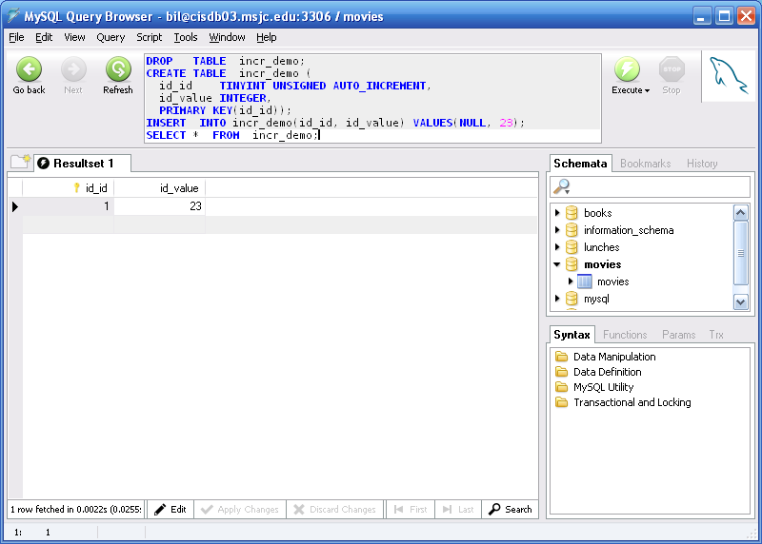
Module 05: Sequences Page D-4: MySQL AUTO_INCREMENT
In this example, we’re using the TINYINY integer datatype to store our auto_increment values.
Note that when NULL values are passed during an INSERT operation that the auto_increment feature ‘kicks in’ and assigns the next value in the series.

Slide 31
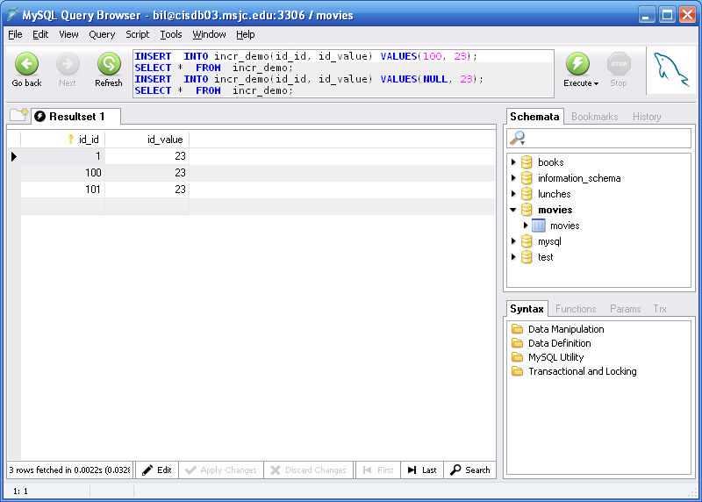
Module 05: Sequences Page D-5: MySQL AUTO_INCREMENT
The programmer can ‘advance the counter’ by explicitly providing a value for the auto_increment column during the insertion operation.
And, the next time a row is inserted, the auto_increment counter continues generating sequential values from this new point forward.

Slide 32
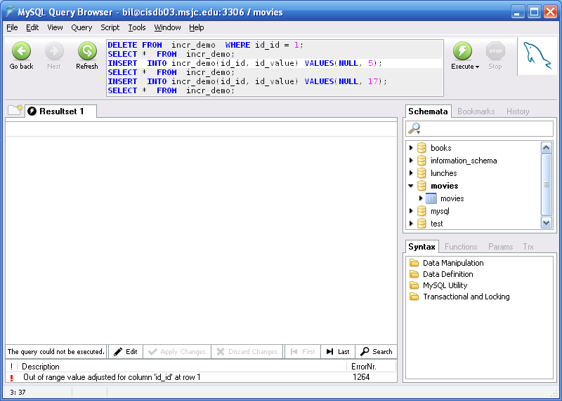
Module 05: Sequences Page D-6: MySQL AUTO_INCREMENT
The largest value a TINYINT column can hold is 255.
In this example you see what happens when the counter is advanced too far.
The record whose key value is 255 is inserted into the table.
But the next attempt to insert a record beyond that point fails.

Slide 33
Module 05: Sequences Page T-1: Terminology
Identifier attributes
Descriptor attributes
Keys
Arbitrary key, synthetic key
CREATE SEQUENCE
DROP SEQUENCE
ALTER SEQUENCE
NEXTVAL.sequence_name
CURRVAL.sequence_name
auto_increment
LAST_INSERT_ID()

Slide 34
Module 05: Sequences Page Z-1: End Notes
Please drop me an email if you noticed any errors in this module. I’d also appreciate reading your comments, criticisms, and or suggestions as to how this module could be improved.
Were there any gaps in the information that was presented (ie. ‘leaps of faith’)?
Was any section unclear?
Did I happen to do a good job? ☺
Thanks,
bil

Slide 35
That’s All

